Slide 1
CS100 Recitation 2
TA name

Slide 2
Outline
Simple Input / Output
Control Flow
Example
Exercise
Code Quality

Slide 3
Simple Input / Output

Slide 4
Output
printf(control-string, argument-list);
Use “%%” to show “%”.
conversion specification
% [flag] [minimumFieldWidth] [.precision] [sizeSpecification] conversionSpecifier
flag: + / - / whitespace
minimumFieldWidth: integer
.precision: used when print float
sizeSpecification: l/ll (e.g. long, long long, double)

Slide 5
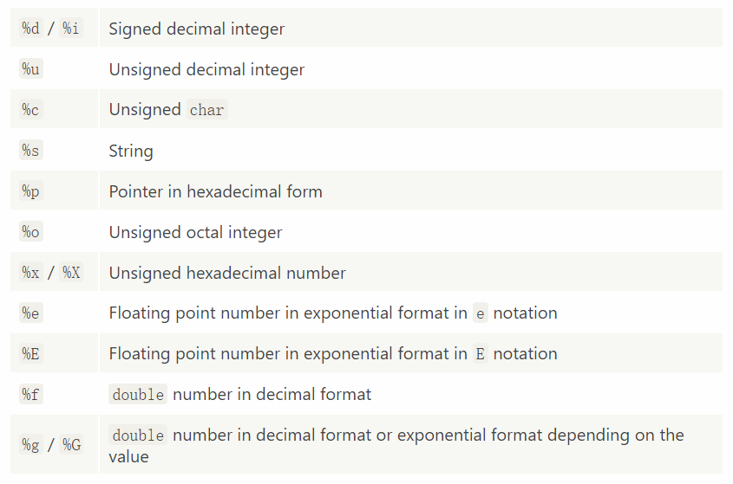
ConversionSpecifier

Slide 6
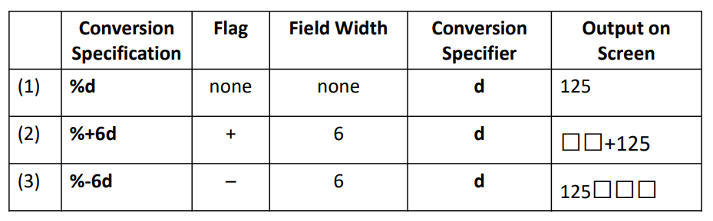
Printing Integer Values 125

Slide 7
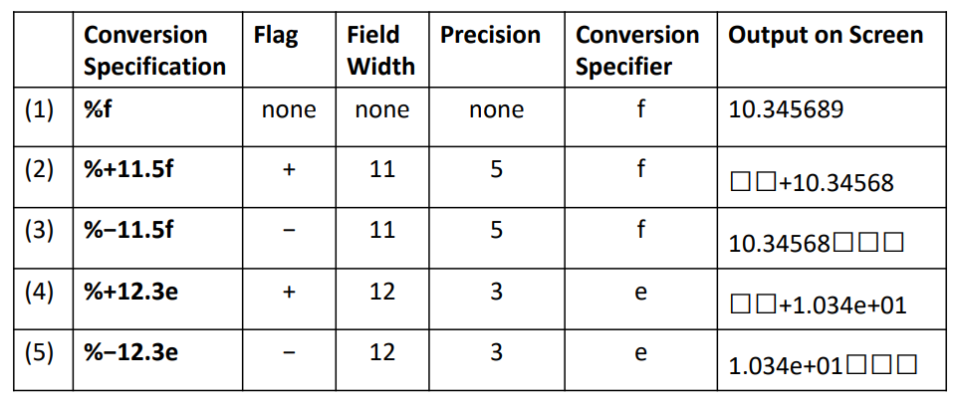
Printing Floating-Point Values

Slide 8
Reference
https://en.cppreference.com/w/c/io/fprintf

Slide 9
Input
scanf(control_string, argument_list);
Whitespace in control-string stands for one or more whitespace.
Cannot directly handle non deterministic number of captures.
Use “%%” to show “%”.
conversion specification
% [*] [maximumFieldWidth][sizeSpecification]
*: capture but not assign to the variable
maximumFieldWidth: maximum characters to read
sizeSpecification: l/ll (e.g. long, long long, double)

Slide 10
Example
control-string: “%4lu%s23”.
Input: 12345ab123
What will happen?
First will become 1234, second will become 5ab123

Slide 11
Example
control-string: “%4lu%s23”.
Input: 12345ab1 23
What will happen?
First will become 1234, second will become 5ab1

Slide 12
Reference
https://en.cppreference.com/w/c/io/fscanf

Slide 13
Control Flow

Slide 14
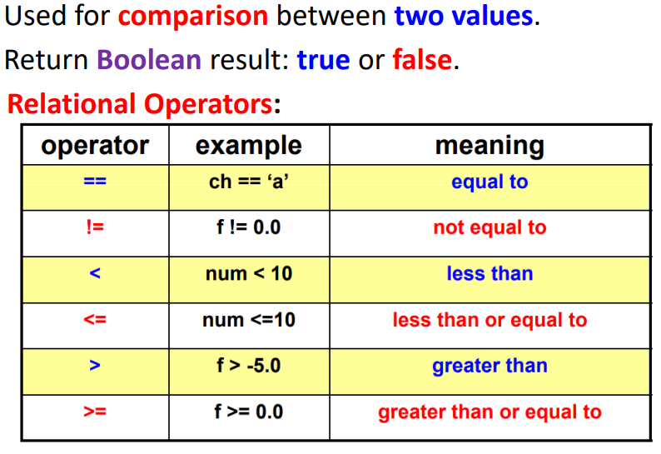
Relational Operators

Slide 15
The if…else if…else Statement
#include <stdio.h>
int main(){
int a = 0;
scanf("%d", &a);
if (a == 1){
printf("Your input is 1.\n");}
else if (a == 2){
printf("Your input is 2.\n");}
else{
printf("Your input is neither 1 or 2.\n");}
return 0;}

Slide 16
Notice
#include <stdio.h>
int main(){
int a = 6;
scanf("%d", &a);
if (a < 5)
if (a == 1)
printf("1");
else
printf("0");
return 0;
}

Slide 17
Switch
Too many else if can be ugly and inefficient
Limitations: Only switch on integers, no strings
Remember to break!
Remember to add default!
Some other languages have much more powerful version of switch. See Pattern Matching

Slide 18
Switch
#include <stdio.h>
int main(){
int a = 0;
scanf("%d", &a);
switch (a){
case 1:
printf("Your input is 1.\n");
break;
default:
printf("Your input is not 1.\n");
break;
}
}

Slide 19
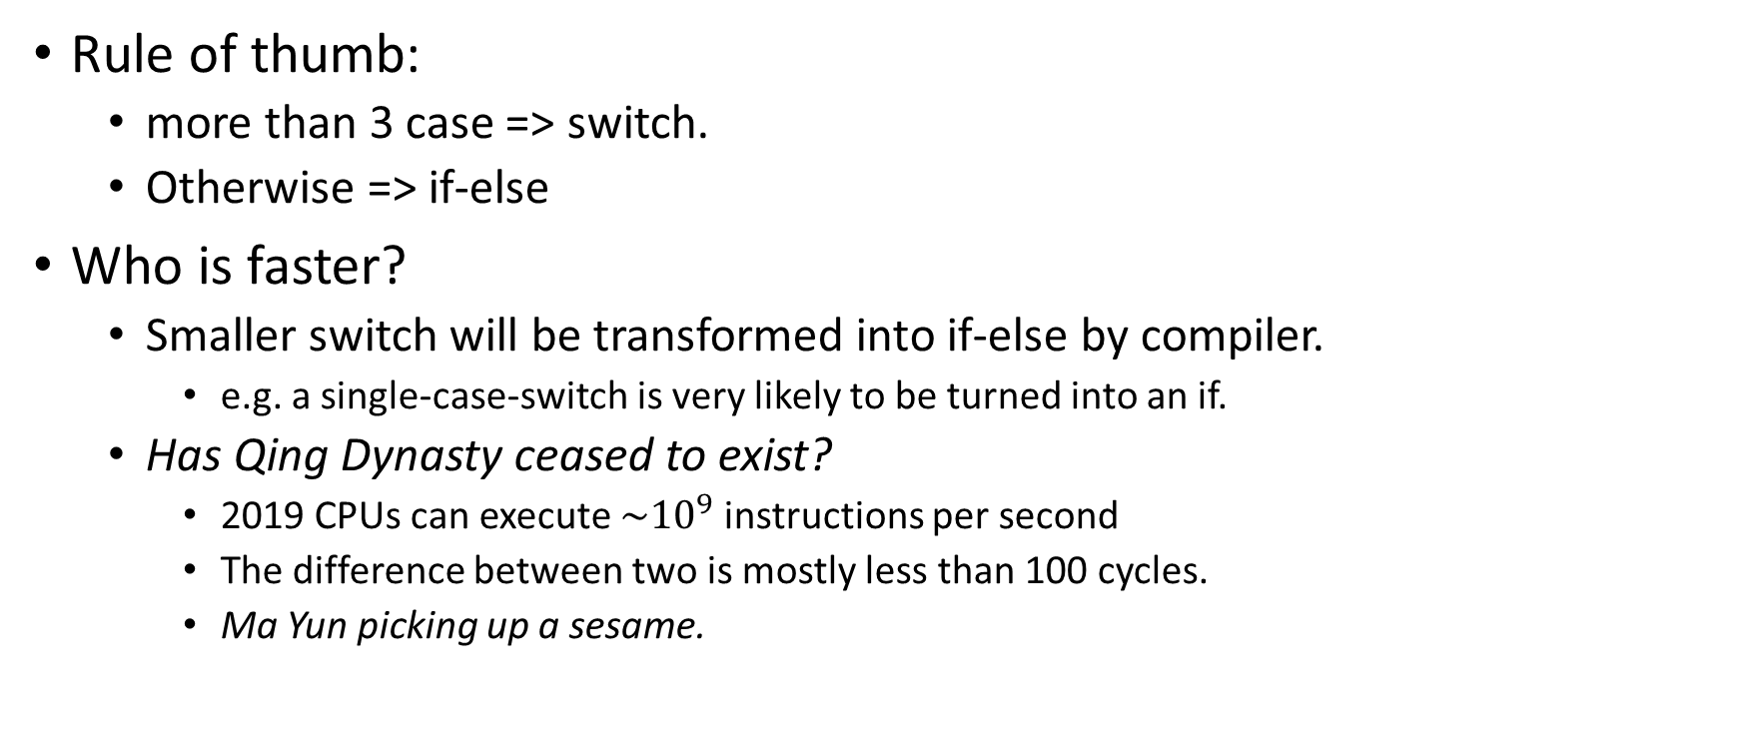
Switch or if-else?
Rule of thumb:
more than 3 case => switch.
Otherwise => if-else
Who is faster?
Smaller switch will be transformed into if-else by compiler.
e.g. a single-case-switch is very likely to be turned into an if.
Has Qing Dynasty ceased to exist?
2019 CPUs can execute ${\sim 10}^{9}$ instructions per second
The difference between two is mostly less than 100 cycles.
Ma Yun picking up a sesame.

Slide 20
While: loop over a condition
#include <stdio.h>
int main(){
int a = 0;
while (1){
printf("Please input 1.\n");
scanf("%d", &a);
if (a == 1)
break;
}
}

Slide 21
For: enhanced loops
#include <stdio.h>
int main(){
int a = 0;
for(int i=0;i<3;i++){
printf("%d",i);
}
}

Slide 22
“for loops”
for(i = 0; i < 100; ++i)
initialization condition increment
For loop is best used when you have a certain start, end, and step.
Otherwise, try using while loops instead.
Also, it’s best to initialize to 0 and use < in condition.
(We count from 0, not 1.)

Slide 23
Nesting
All control structures can be nested in any other structure indefinitely many times.
Too many levels signal bad design.
Use functional decomposition
Extract portion into functions
Otherwise
Hard to read, it could go outside of the right bound of the screen.
Hard to maintain, as it obscure the control flow.

Slide 24
Nesting: HAZARD
for (int i = 0; i < n; i++) {
foo(i);
if (...) {
for (int j = i; j < n; j++) {
if (test(j))
for (int k = j; k > i ; k++) {
bar(k);
}
}
break;
}
}

Slide 25
Example
.

Slide 26
Prime
#include <stdio.h>
int main(){
int num = 0;
scanf("%d", &num);
for (int i = 2; i < num; i++){
if (num % i == 0){
printf("%d is not a prime.\n", num);
return 0;
}
}
printf("%d is a prime.\n", num);
return 0;
}

Slide 27
Multiplication Table
#include <stdio.h>
int main()
{
for (int i = 1; i <= 9; i++)
{
for (int j = 1; j <= 9; j++)
{
printf("%d*%d=%d ", i, j, i * j);
}
printf("\n");
}
}

Slide 28
Multiplication Table （a small improvement）
#include <stdio.h>
int main()
{
for (int i = 1; i <= 9; i++)
{
for (int j = 1; j <= 9; j++)
{
printf("%d * %d = %2d ", i, j, i * j);
}
printf("\n");
}
}

Slide 29
Exercise

Slide 30
Exercise
A simple calculator that only support plus, subtract, multiply and divide.
Input: ”number1 operator number2” (e.g. “1+2”)
Output: The result (e.g. “3”)

Slide 31
Code Quality

Slide 32
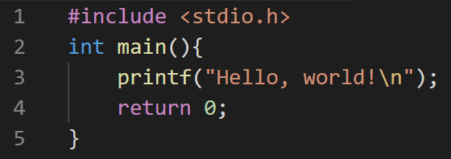
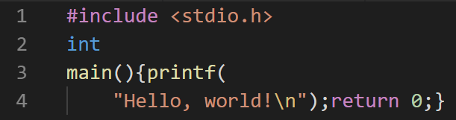
Coding style: Why important?
You want codes like this: Not this:
And of course not this:

Slide 33
Coding style: Why important?
Makes code easier to read for others.
Easier to read for yourself!
Otherwise, you will soon lose track if you start on a project that you haven’t worked on for a while.
Makes code consistent when co-operating with other people.
(Also makes code aesthetically pleasing)

Slide 34
Coding style: Why important?
Rule at thumb:
Pretend somebody else is reading your code.
This guy will be yourself three month later.

Slide 35
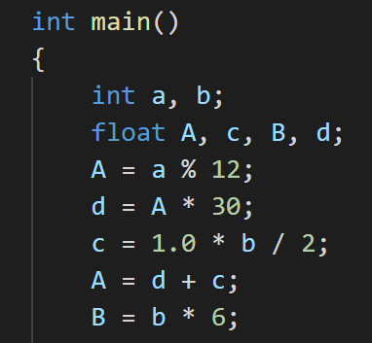
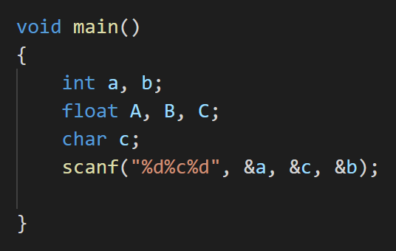
Naming variables
Do not use void main()!
Use int main() instead

Slide 36
Naming variables
Good variables names:
Reflects its value
Eliminates ambiguity
Examples:
Good names:
totalOfAllSelectedItem, totalOfAllUnselectedItem, a_very_long_variable_name, …
Bad names:
a, b, c, d… aa, aaaa, A, NAME, O0oOlIL1I, …

Slide 37
Naming variables
Don’t worry if it gets too long!
Solutions:
1. add underscores(_) or hyphens(-).
score_CS100_Shanghaitech_students
2. camelCase (小驼峰命名法)
Capitalize the first letter of each word except the first one
variableNamingUsingCamelCase
TIP: We do not recommend any variable name which begins with a UPPERCASE LETTER!

Slide 38
Naming schemes
Snake case
this_is_a_variable
it_has_no_upper_case_letter
Little camel case
g_globalVariable
thisIsAnIntegerVariable
Some prefer to prepend several letters to indicate the variable type
Big camel case
ThisIsAFunction
Do not use this for variables. Only functions or classes (C++).
Notes:
We do not enforce one, but we strongly encourage you to choose one and stick to it.

Slide 39
Commenting
Meaningful comments
Key implications, side effects
Known issues
Complicate calculus/control flow/binary magic/magic number
Regular expressions
Not transliteral of your code
No: “z=x*y; // This line multiples x by y and store it in z”
Yes: “z=x*y; // This calculate the total and store it in z”
Better: “total = quantity * price;”
Good naming remove the need of commenting!
Most inexperienced developers don’t know how to do so though……

Slide 40
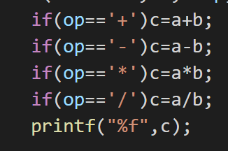
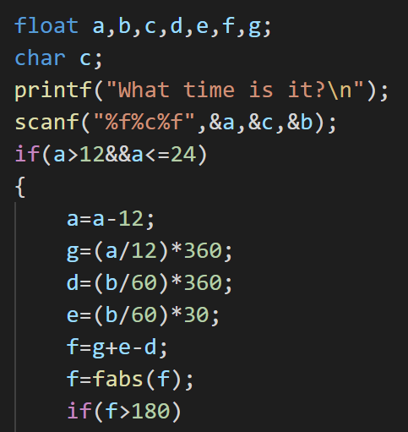
Whitespaces

Slide 41
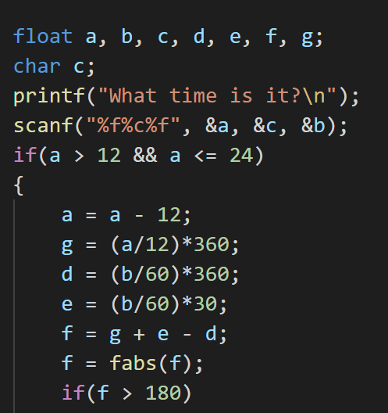
Whitespaces
Before & after some operators like +, -, ==, >, and =.
After any comma(,).
int a = 3, b = 4, c = 5;

Slide 42
Whitespaces
Not convinced? Look at this:
Which of the residual calculation expressions look cleaner?
for(int i=0;i<15;++i){
double t_i=(8.0-i-1.0)/2.0;
residual=x1*exp(-x2*(t_i-x3)*(t_i-x3)/2.0)-y;
}
for (int i = 0; i < 15; ++i) {
double t_i = (8.0 - i - 1.0) / 2.0;
residual = x1 * exp(-x2 * (t_i - x3) * (t_i - x3) / 2.0) - y;
}

Slide 43
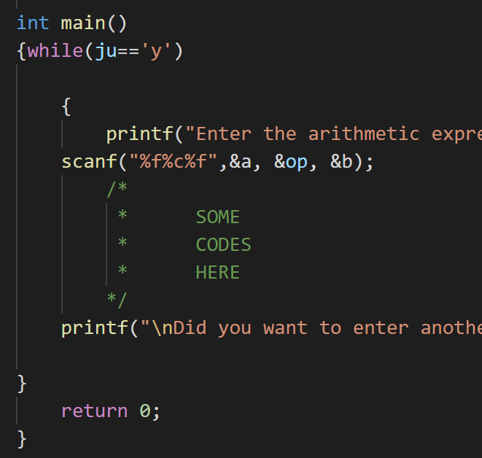
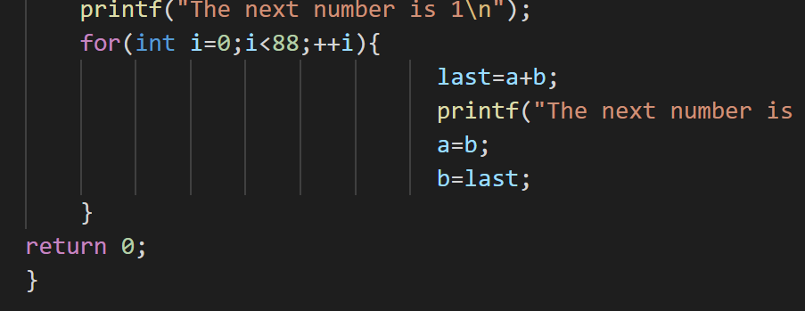
Indenting

Slide 44
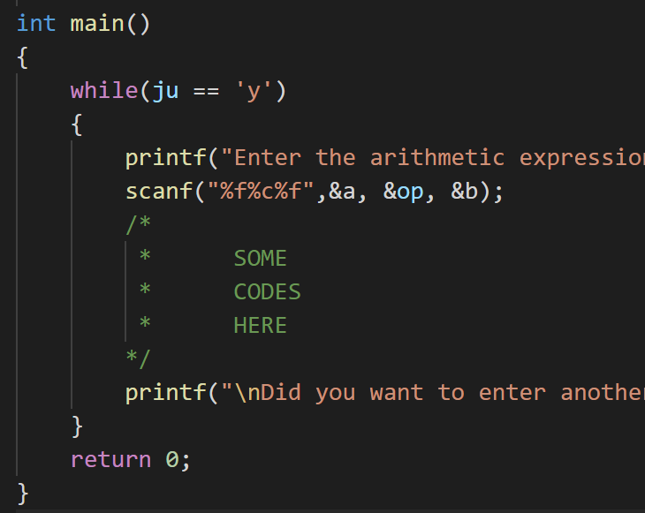
Indenting
Organize your code blocks with indents.
A general rule: an open bracket( { ) → increase an indent
a closed bracket( } ) → decrease an indent
An indent can be a tab, two, four or eight spaces.

Slide 45
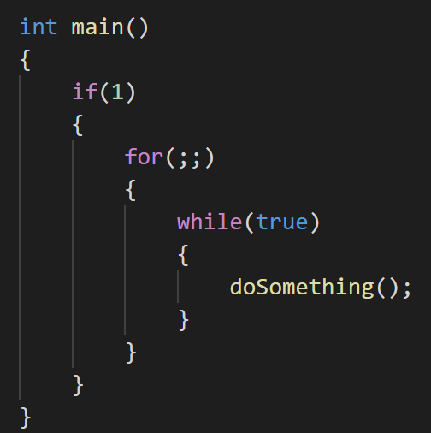
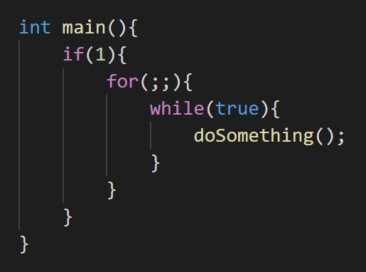
Own line for curly braces?
There are two styles when you open a curly brace:
In a new line: In the previous line:

Slide 46
Own line for curly braces?
There is NO right or wrong for this question!
It’s totally personal preference!
Once again, although there are a lot of debates, this is a TRIVIAL problem!
However, it is strongly recommended and often mandatory to follow the style guide of your project.
Stay consistence with yourself and your surroundings.
We don’t allocate a line for braces because there
is insufficient line space on the slides

Slide 47
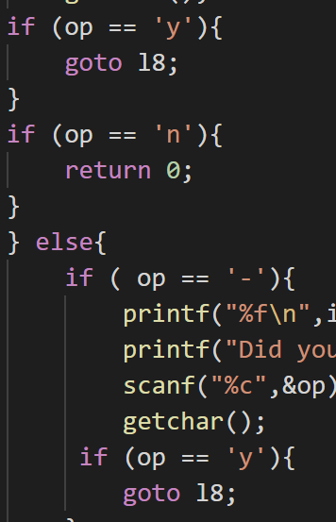
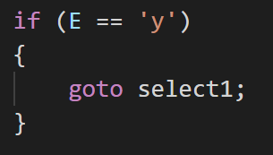
“goto” is evil!
Goto statement is considered unsafe, as it might mess up the structure of your code.
When you are about to write a “goto”, write a while loop instead!
Unless absolutely necessary, don’t use it.

Slide 48
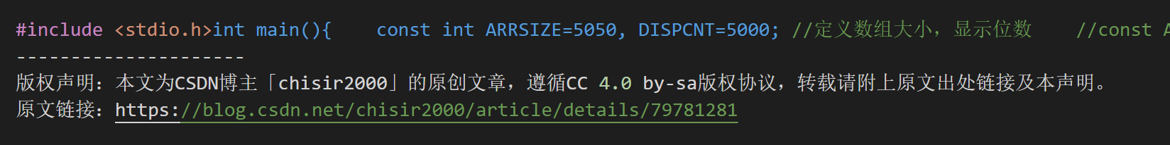
Last: Do not copy others’ codes!
Even open-source codes are forbidden in this course.
Please read rules of academic conduct carefully!

